Slide 1
Pitch and formants estimation
A project of Speech Processing and Recognition Course
University of Genoa
Zeinab Namakizadeh Esfahani
4786728

Slide 2
Main concepts
model the languages, determine the age, gender, emotion of the speaker
Pitch is the fundamental frequency of a signal excitation
quasi periodic
Formants mainly vary due to the phoneme being articulated rather than age, gender, etc
a digital time varying filter
Noise
Window
Signal is not stationary!!
Duration of the frame
Hamming

Slide 3
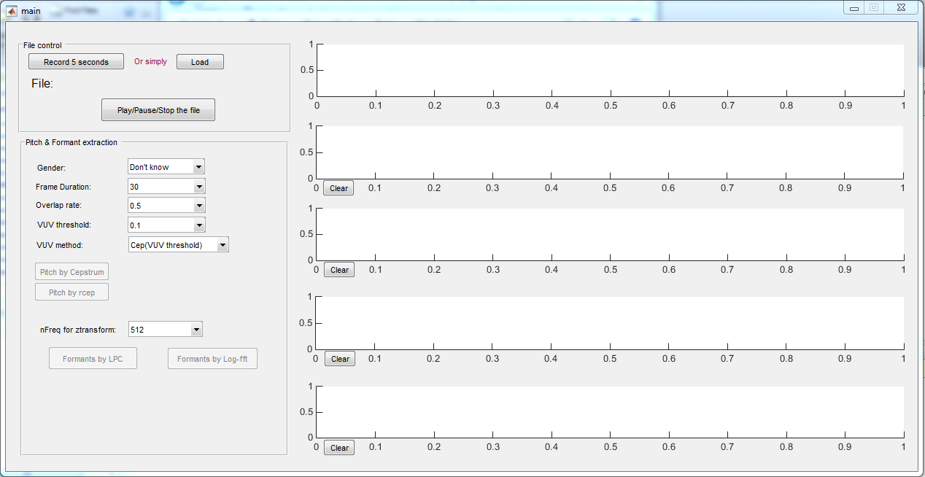
GUI

Slide 4
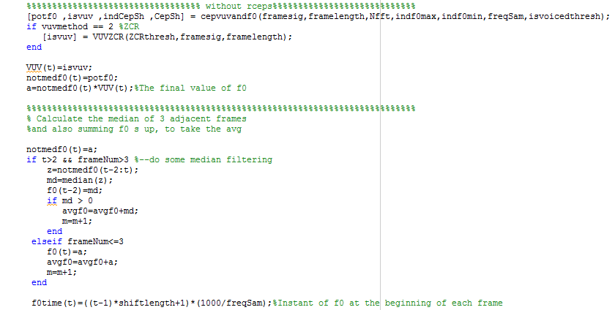
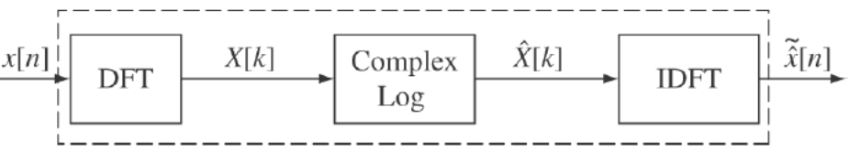
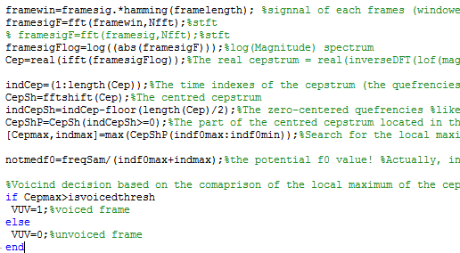
Pitch Extraction

Slide 5

Pitch Extraction-

Slide 6
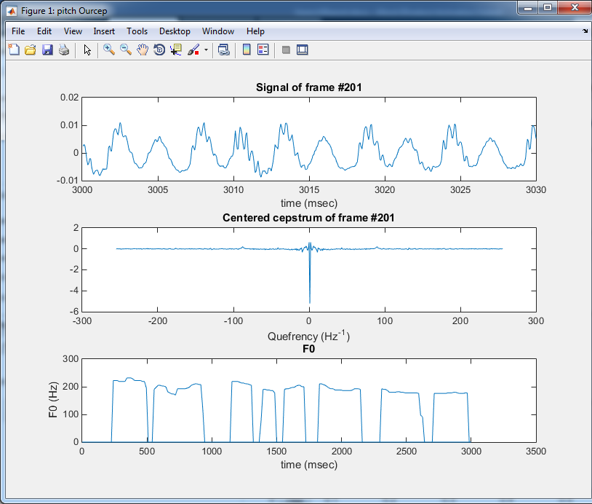
Pitch result
Compared to rceps just to check the pipeline works fine

Slide 7
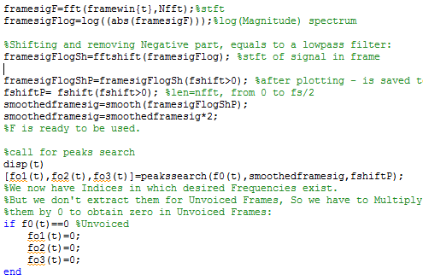
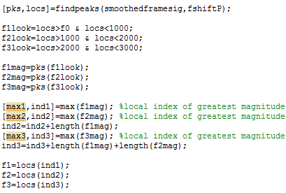
Formant Extraction

Slide 8
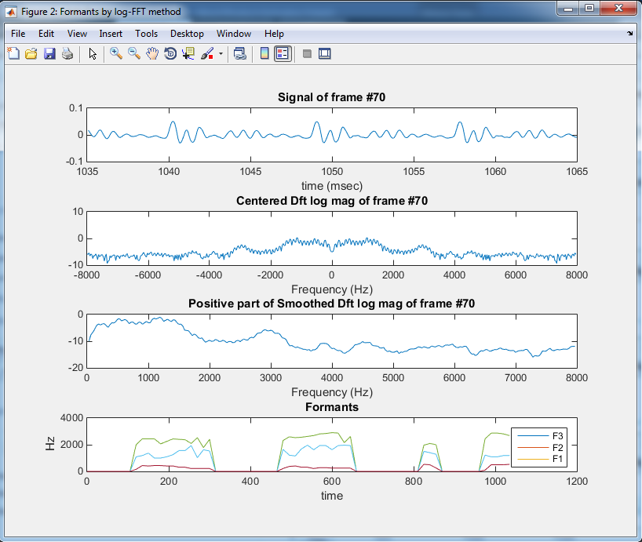
Formant result
Compared to lpc method to check the results

Slide 9
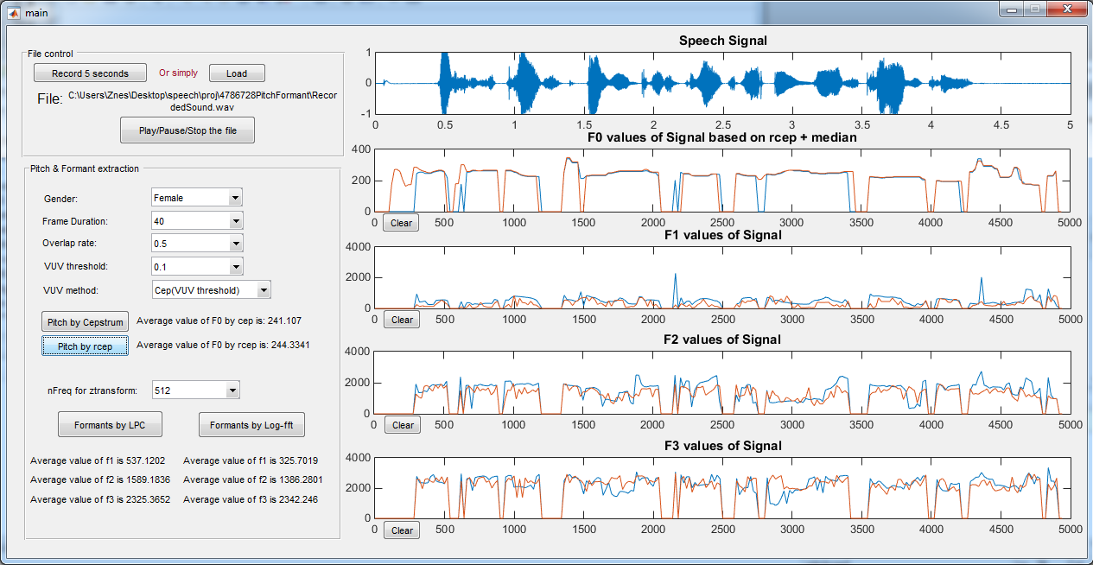
Final main window

